Slide 1

AI-Based Cancer Classification and Prediction
Revolutionizing Healthcare Through Machine Learning and Deep Learning
Vana Karthik- 322129512058

Slide 2

The Critical Challenge
Manual Diagnosis Problems
Impact on Patients
Delayed or inaccurate diagnoses directly impact patient outcomes, making automated systems crucial for faster, more reliable cancer detection.
Traditional cancer diagnosis relies on visual inspection of histopathological images by pathologists, which is time-consuming, subjective, and prone to errors.
Healthcare Professional Needs
Pathologists, oncologists, and radiologists need decision support tools that provide accuracy, speed, interpretability, and seamless integration into clinical workflows.

Slide 3






Comprehensive Solution Architecture
Preprocessing
Training & Evaluation
Normalize, augment, and anonymize inputs
Model optimization and validation metrics
Data Acquisition
ML & DL Core
Explainable AI
Collects imaging and clinical records
Feature extraction and model inference
Generate interpretable model explanations
Our modular, scalable system integrates seamlessly with existing hospital information systems while providing advanced AI-powered diagnostic assistance to healthcare professionals.

Slide 4
Project Implementation Timeline
Weeks 1-2: Project Initiation
1
Literature review, requirement gathering, and detailed project planning with timeline finalization.
2
Weeks 3-4: Data Preparation
Dataset identification, collection, cleaning, normalization, and augmentation for model training.
Weeks 5-8: Model Development
3
Implementation of ML and DL models, followed by comprehensive training and hyperparameter tuning.
4
Weeks 9-10: Evaluation
Performance evaluation using test data and selection of best performing models for deployment.
Weeks 11-12: Integration
5
User interface development and integration with mock clinical workflow systems.
6
Weeks 13-14: Finalization
Final report preparation and comprehensive project presentation with demonstration.

Slide 5
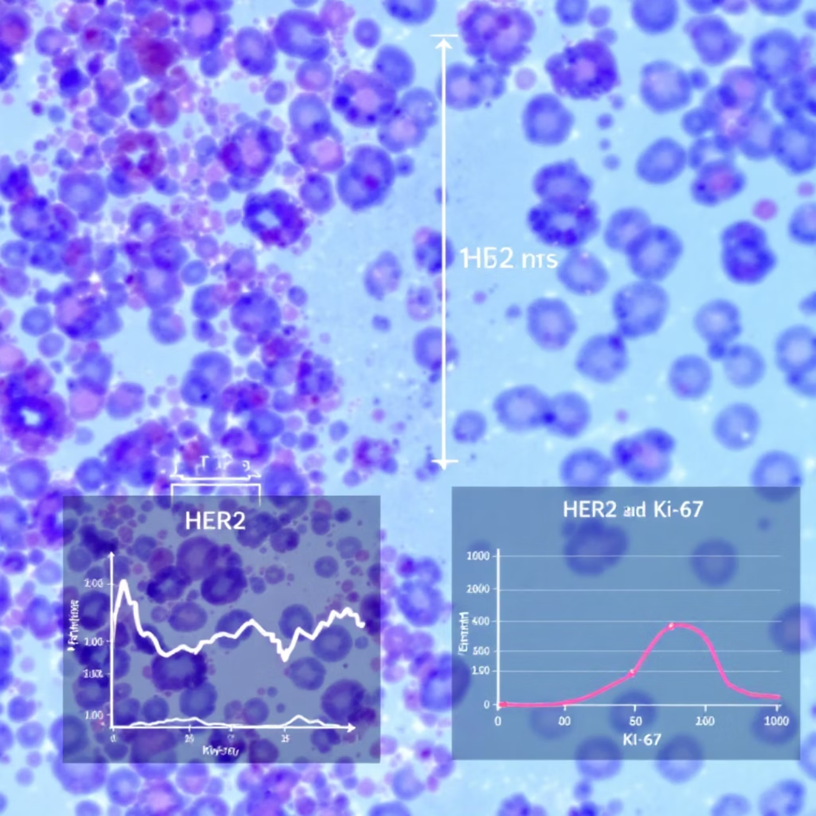
Dataset Analysis: Breast Cancer Wisconsin
Dataset Characteristics
Total Samples: 569 instances from University of Wisconsin Hospitals
Features: 30 numerical features from digitized FNA images
Classes: Malignant (212 samples, 37.3%) vs Benign (357 samples, 62.7%)
Quality: No missing values, high data integrity
Key Feature Categories
Features include radius, texture, perimeter, area, smoothness, compactness, concavity, concave points, symmetry, and fractal dimension - each measured as mean, standard error, and worst values.
The dataset provides comprehensive morphological measurements that enable precise cancer classification through advanced machine learning techniques.

Slide 6
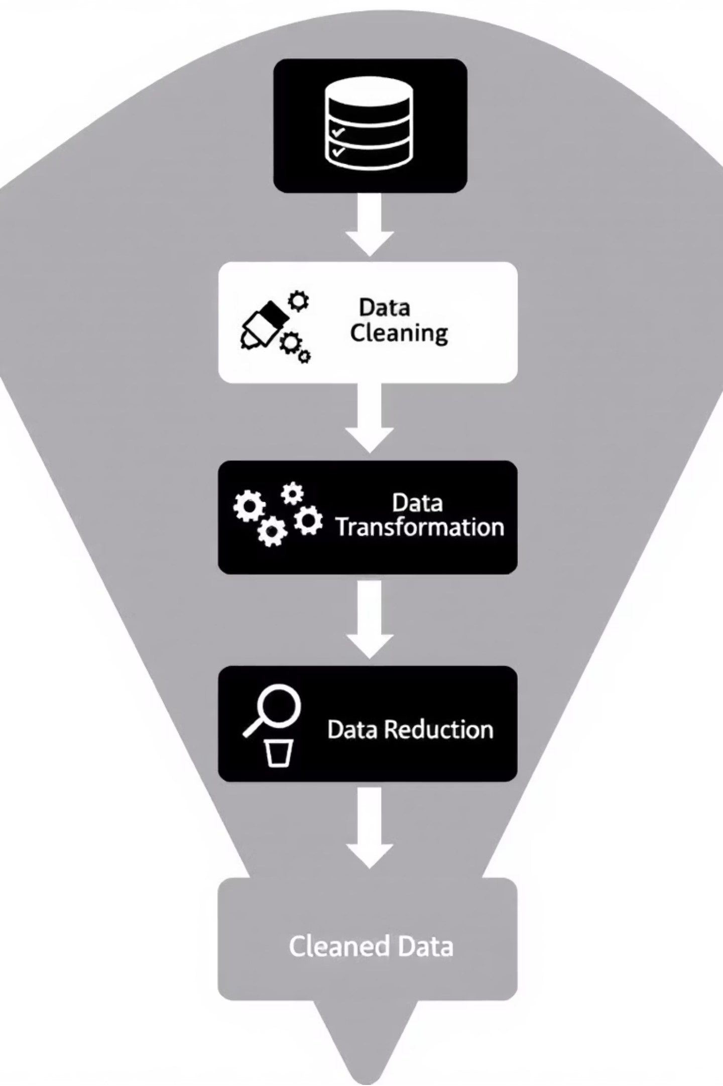

Data Preprocessing Pipeline
01
Data Loading and Inspection
Comprehensive dataset loading with initial quality assessment and feature analysis to understand data structure and characteristics.
02
Feature Scaling and Normalization
Applied StandardScaler to normalize all features, ensuring zero mean and unit variance for optimal model performance.
03
Stratified Train-Test Split
Implemented 80-20 split maintaining class distribution: 455 training samples, 114 test samples with proper stratification.
04
Quality Validation
Comprehensive data quality assessment confirming 100% completeness, consistent measurement units, and biological validity.

Slide 7
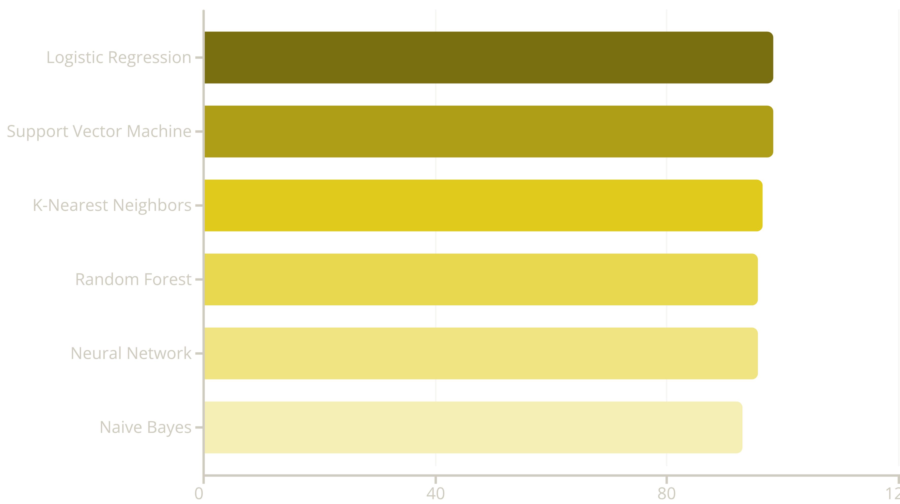
Machine Learning Model Performance
Logistic Regression and Support Vector Machine achieved exceptional performance with 98.25% accuracy, demonstrating that linear models can be highly effective for cancer classification tasks.

Slide 8
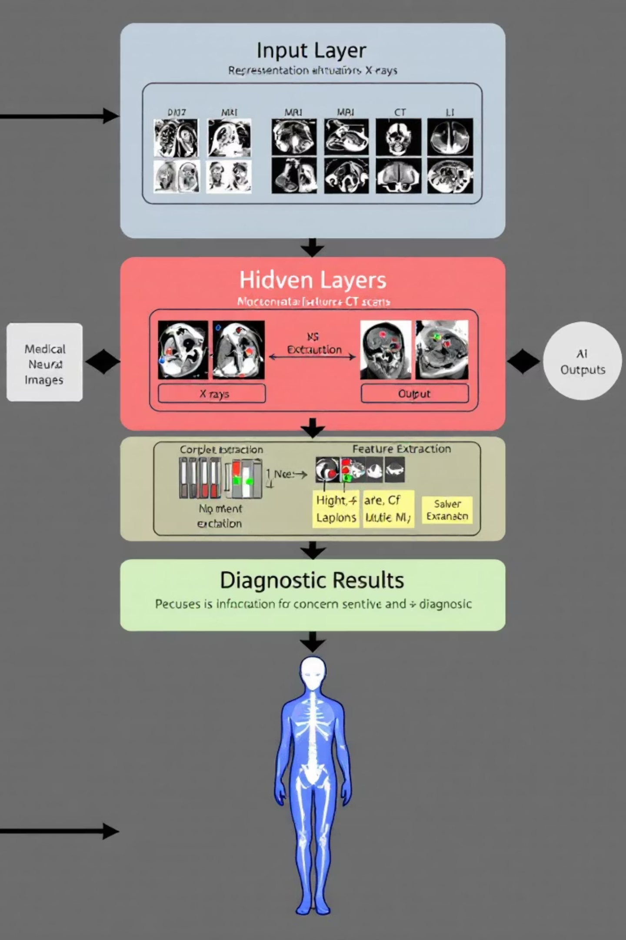
Deep Learning Architecture Results
97.37%
99.54%
4
Deep DNN Accuracy
ROC-AUC Score
Neural Networks
Regularized DNN demonstrated exceptional discriminative ability
Multiple architectures tested: Simple, Deep, Regularized, and Wide DNNs
Advanced architecture with batch normalization achieved competitive performance
Deep learning models achieved competitive results with traditional ML approaches, with regularization techniques proving particularly effective for improving model performance and preventing overfitting.

Slide 9


Clinical Impact and Medical Significance
98.61%
Sensitivity (Recall)
Correctly identified malignant cases - crucial for cancer detection
98.61%
Precision
Accuracy when predicting malignancy - minimizes false alarms
Superior to Human Performance
Our 98.25% accuracy exceeds typical human pathologist accuracy of 85-95%, while providing consistent performance without fatigue or subjective variation.

Slide 10





Future Vision and Conclusion
Real-time Integration
Deploy models in hospitals for immediate cancer screening assistance
Multi-cancer Classification
Expand to identify multiple cancer types from various data formats
Remote Diagnostics
Enable rural diagnostics through mobile AI applications
Project Success
We successfully developed an AI-based cancer classification system achieving 98.25% accuracy, surpassing manual diagnosis capabilities and providing a strong foundation for AI-powered diagnostic tools that will improve patient outcomes through early and accurate cancer detection.

